Slide 1
Project ”ART GALLERY”
Presentation
By
Lajvanti Sonaiya

Slide 2


NARANDAS JETHALAL SONECHA MANAGEMENT AND TECHNICAL INSTITUTE [AT: CHANDUVAV, VERAVAL]

Slide 3

INTRODUCTION
WHAT
WHY
An E-commerce website to sell wall art paintings of Oils, Spray and water color
Delivering our customer, a satisfying and safe purchase experience
Reliable business strategy
Personal connect with clients
Simplification of Customer management
Competence of Services

Slide 4

FUNDAMENTAL REQUIREMENTS
Computer System and basic hardware
Stable Internet Connection
Basic Technical knowledge
Payment system
Technical Support
Operational Telecommunication System

Slide 5

PROBLEM DEFINITION
The purpose of any e-commerce website is to help customers narrow down their broad ideas and enable them to finalize the products they want to purchase. For example, suppose a customer is interested in purchasing a décor piece. His or her search for the same should list artists, type of the piece , size , and all other features as facets. As the customer selects more and more features or options from the facets provided, the search narrows down to a small list of mobiles that suit his or her choice. If the list is small enough and the customer likes one of the mobiles listed, he or she will make the purchase.

Slide 6

CORE COMPONENTS
User interface app components
display dashboards
notifications, and logs
Structural components
HTML
CSS
Python
Django

Slide 7
PROJECT PROFILE
Project Profile | Art Gallery Website
Project Category | Web Development
Front End | Python (Django)
Back End | Django
Browser | Google Chrome, Mozilla Firefox, Microsoft Edge
Operating System | Windows
Documentation | Microsoft word 2010 or Higher
Developed By | Lajvanti , Kajal and Upasana
Project Guide | Prof. Dhruvi Sidhpura
Submitted To | Narandas Jethalal Sonecha Management and Technical Institute
University | Gujarat Technological University (GTU)

Slide 8
REQUIREMENT DETERMINATION
Requirements determination involves studying the existing system and gathering details to find out what are the requirements, how it works, and where improvements should be made

Slide 9
TARGETED USERS
Segments of Targeted User
Home Collectors
Interior designers
Investors
People with an immediate need for art
Art lovers

Slide 10

SYSTEM DESIGN
UML Diagrams
Class Diagram
Interaction Diagrams
Activity Diagrams
SDLC

Slide 11
Register Online
Add Products
Customer
Search Product
Manage Orders
Admin
Add to Cart
Send Confirmation
Fill Details
Review Form
Checkout

Slide 12
Customer
System Order
+ ID: Intchar
#Password: encrypted
+Oil Paintings
+ Water color paintings
+ Spray Painting
+ Customer Id & PWD
+ Payment Option
CLASS DIAGRAM
+ Login
+ Select the product
+ Place order
+ Payment
Customer Select
Payment Option
Delivery of Order
Payment
+ Amount
+ Payment option
Chk_order
+ Check the order
+ Deliver the order
Cash on Delivery
+ Customer Name
+ Customer Address
+ Amount

Slide 13
Login to Systems
Check Roles of Access
Admin
Admin
INTERACTION DIAGRAM
Manage Products
Manage Products
Manage cart details
Forgot Password
Forgot Password
Check credentials
Check credentials
Manage Module
Manage Module
Manage order Details
Manage order Details
Manage Customer Details
Manage Customer Details
Send Email To User
Send Email To User
Manage card items
Manage card items
Manage cash details
Manage cash details
Manage System Admin
Manage System Admin
Manage user permission
Manage user permission
Manage Report
Manage Report

Slide 14
START
Admin is registered
ACTIVITY DIAGRAM (LOGIN)
Admin Login ID and Password
Check Login ID Password
Invalid username/ Password
Login to the system successfully
Set User level and permissions
END

Slide 15
Preliminary Investigation
SDLC MODEL
Determination of system Requirements
Design of system
Development of Software
System Testing
Implementation Evaluation & Maintenance

Slide 16
DATA DICTIONARY
OrderPlaced Table:-
Picture Table:-
Cart Table:-
Field Type | Data Type
user | CharField(FK)
picture | CharField(FK)
quantity | PositiveIntegerField
FieldType | DataType
user | CharField(FK)
customer | CharField(FK)
pictures | CharField(FK)
quantity | PositiveIntegerField
ordered_date | DateTimeField
status | CharField
Field Type | DataType
title | CharField
price | FloatField
desc | TextField
category | CharField
image | ImageField
Feedback Table:
Customer Table:-
FieldType | DataType
name | CharField
email | CharField
subject | CharField
message | TextField
Field Type | DataType
user | CharField(FK)
name | CharField
city | CharField
state | CharField
zipcode | IntegerField
address | CharField

Slide 17
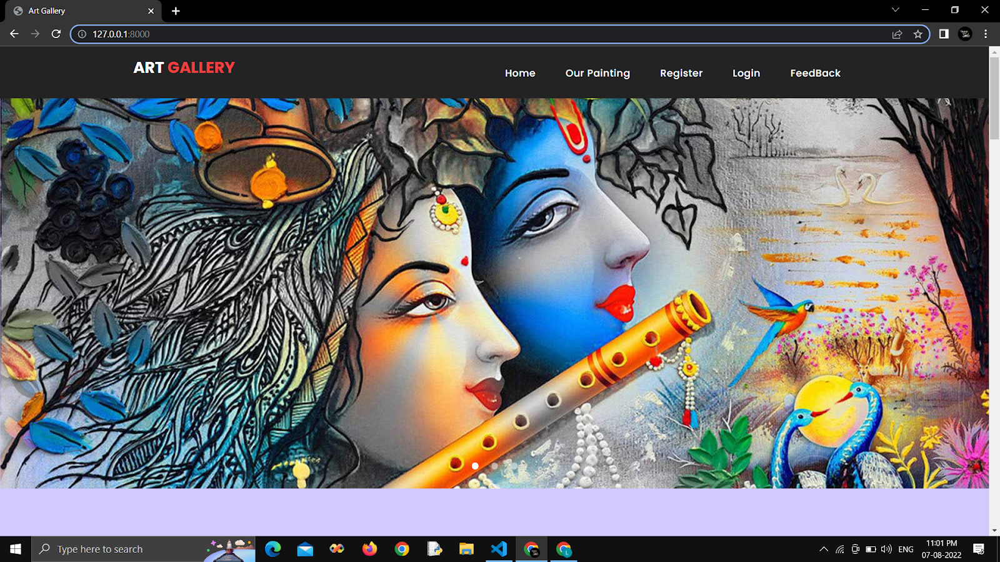
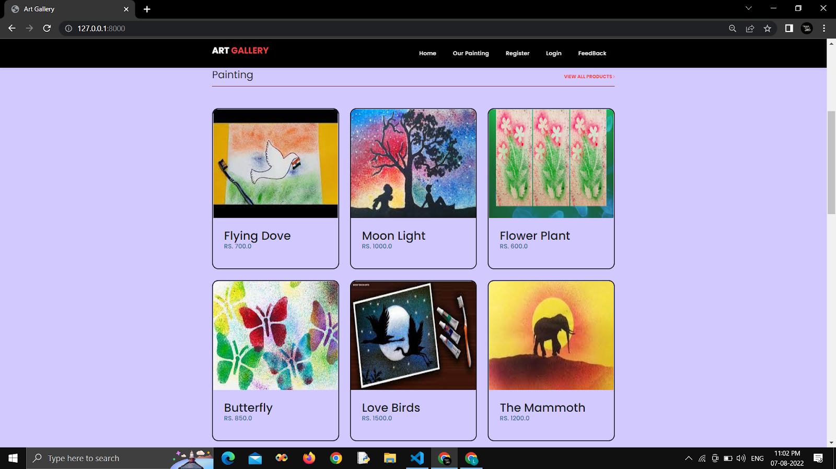
Home page:

Slide 18
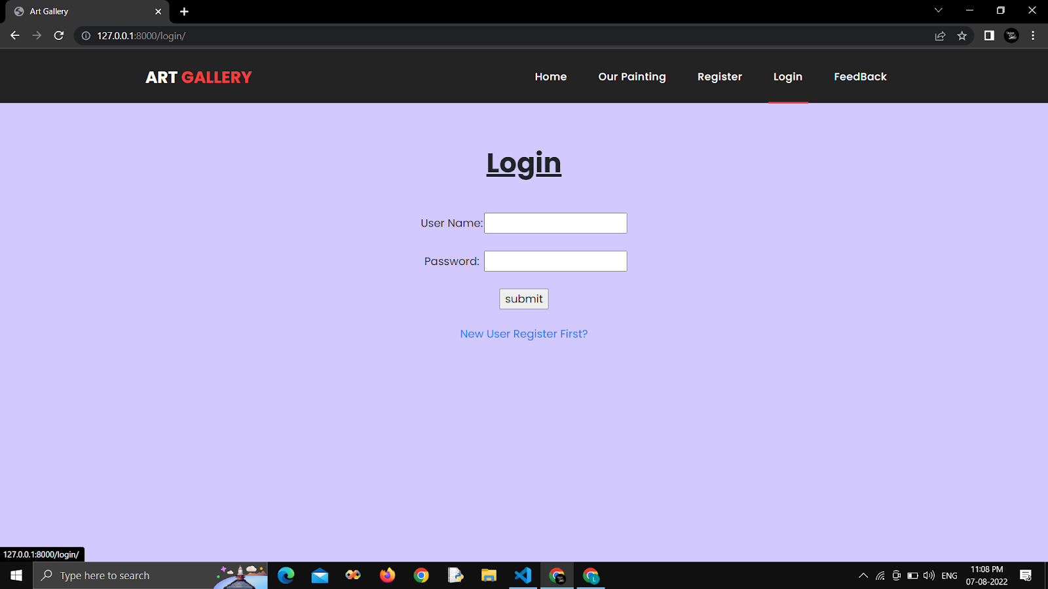
Login page:

Slide 19
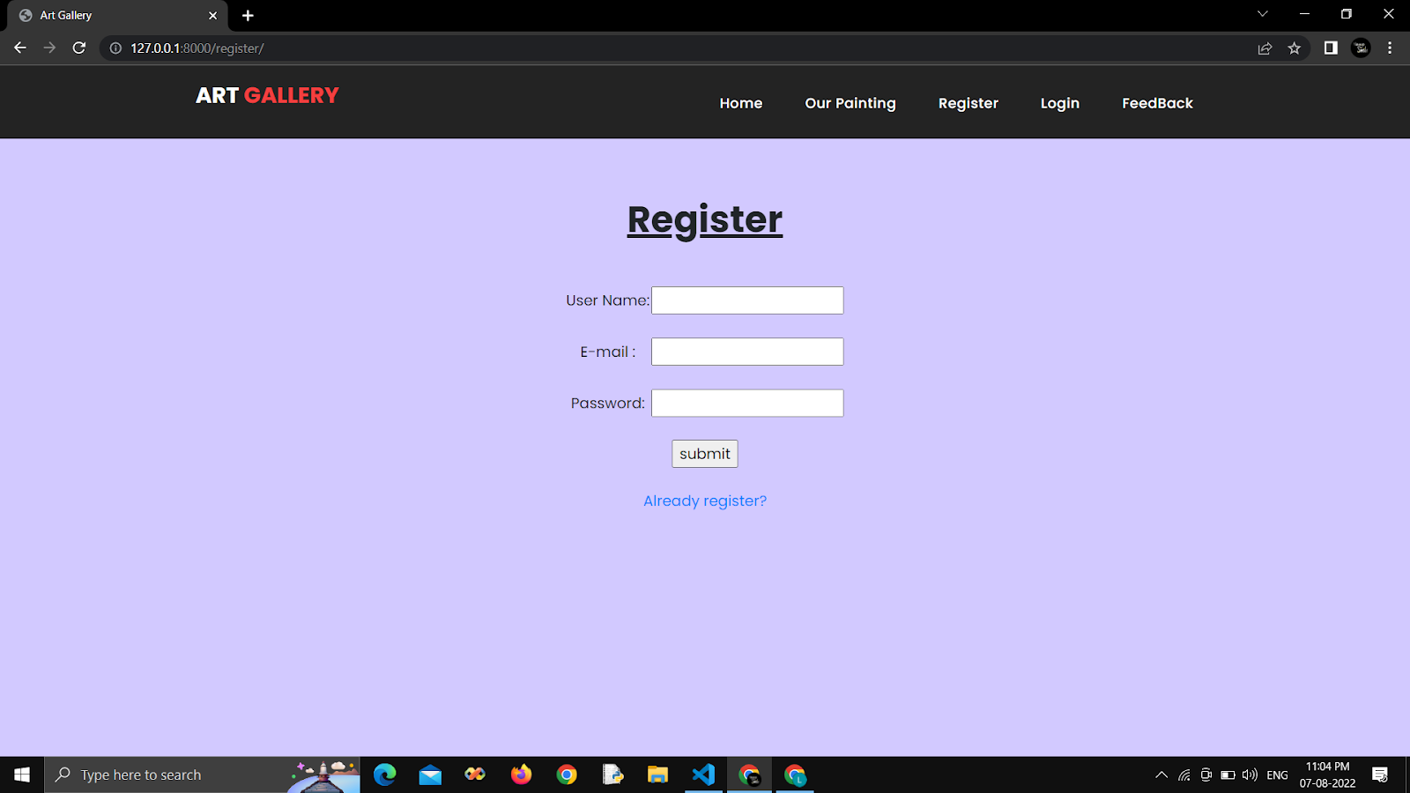
Registration page:

Slide 20
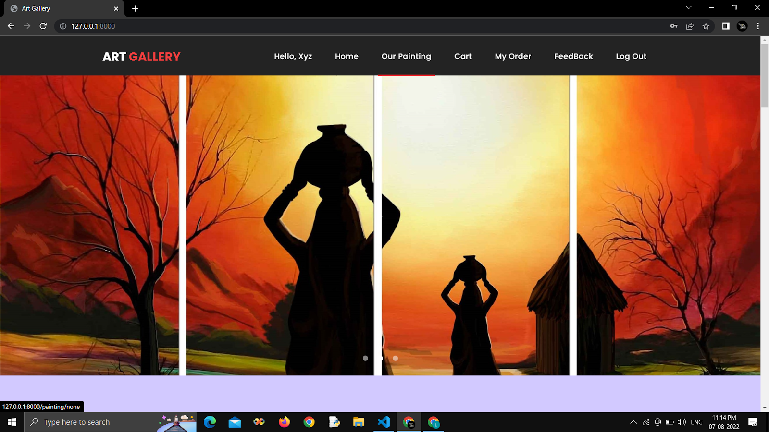
After Login Home page:

Slide 21
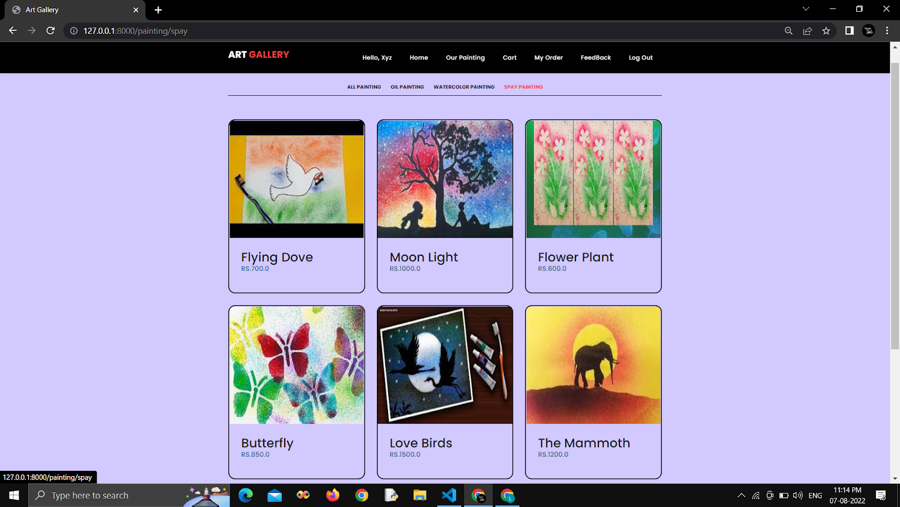
Painting Page

Slide 22
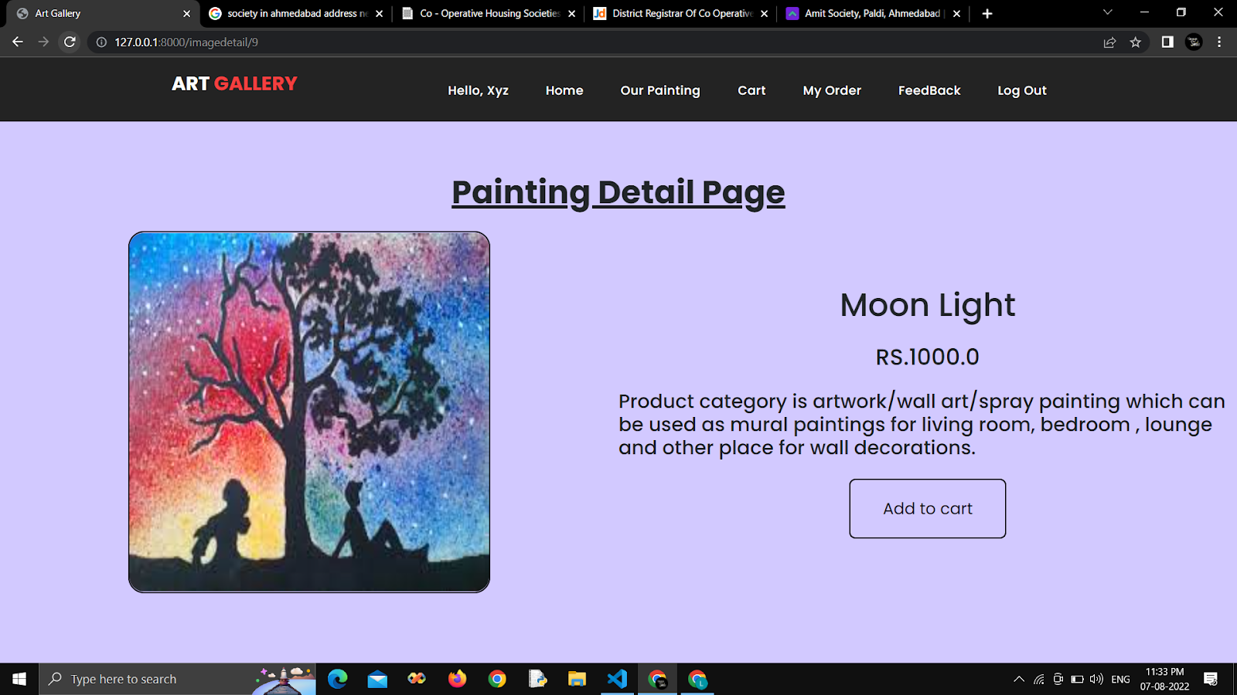
Painting Detail Page

Slide 23
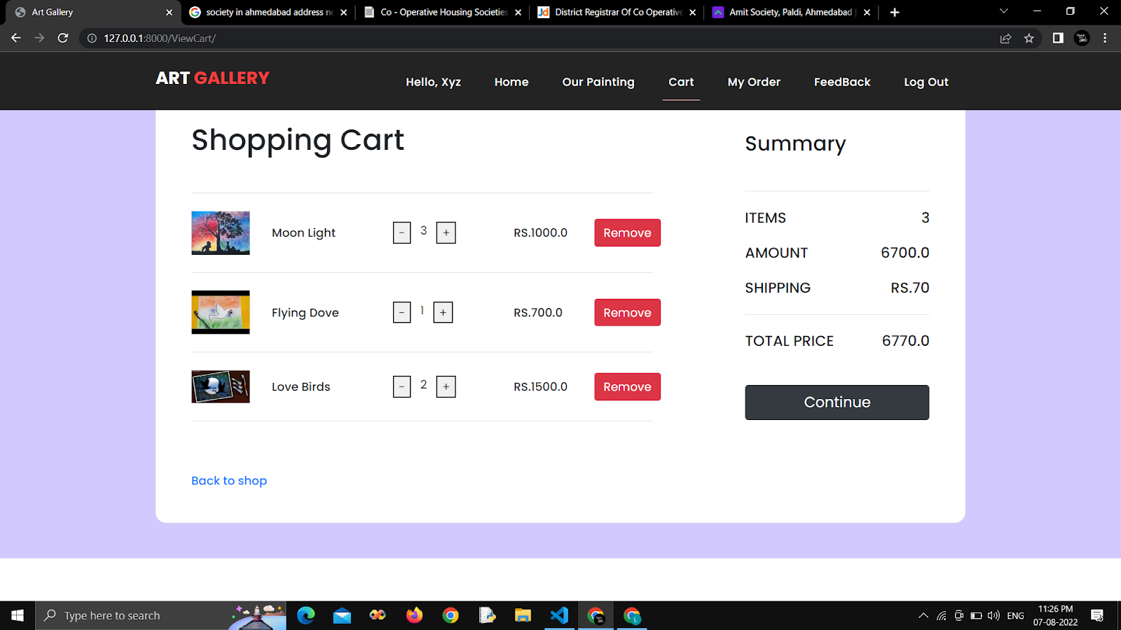
Cart Page

Slide 24
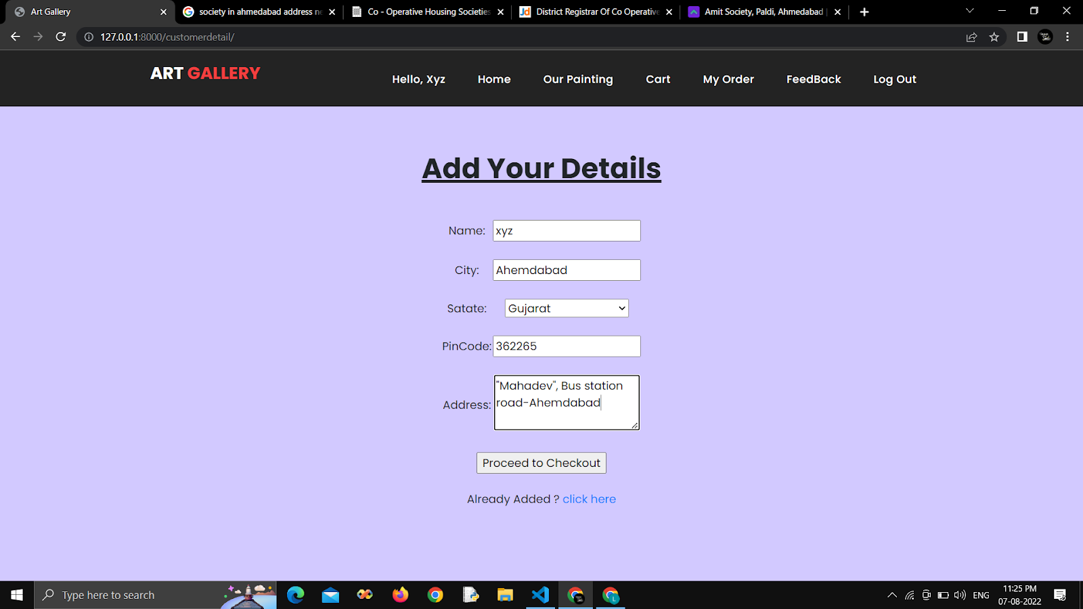
Customer Detail Page

Slide 25
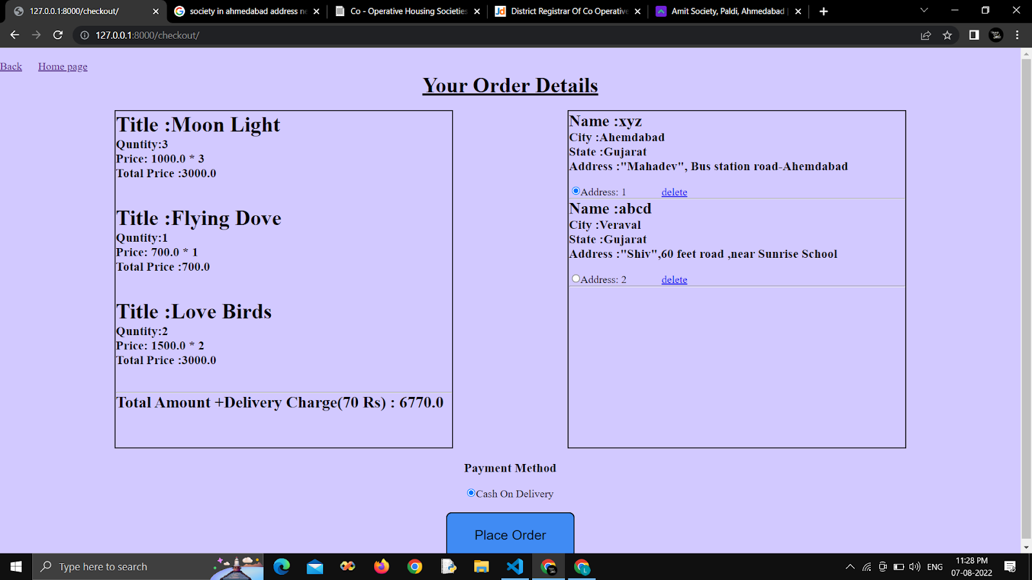
Customer Detail Page

Slide 26
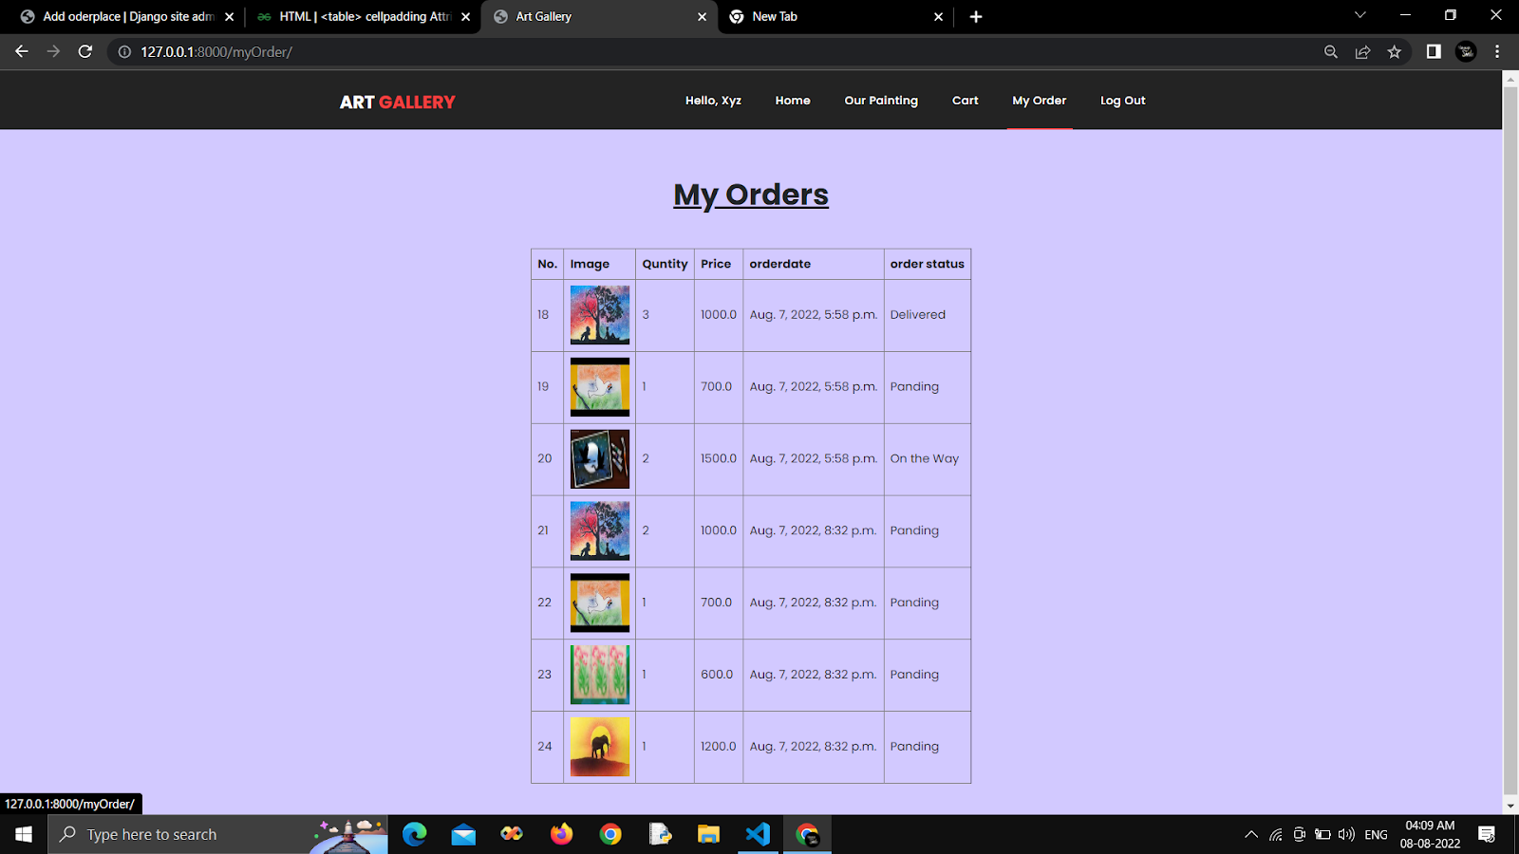
Order Detail Page

Slide 27
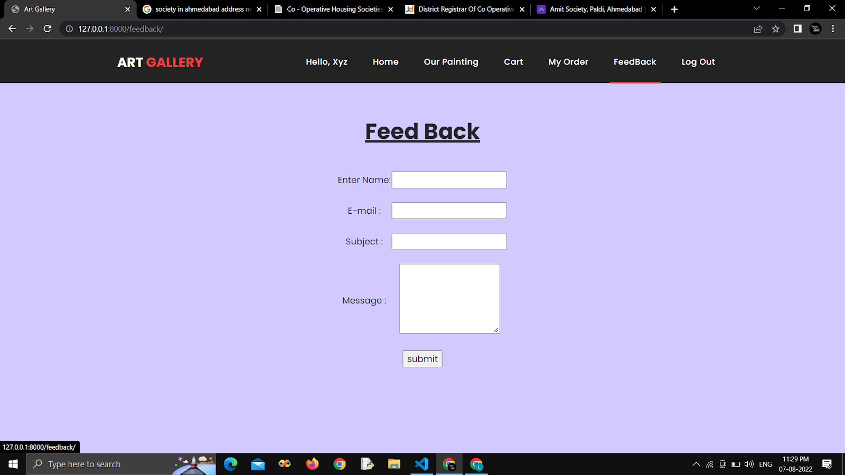
Customer Detail Page

Slide 28
BIBLIOGRAPHY
To develop this “Web application of online paintings selling” we used Python(Django) as front end and back. We take some knowledge towards automation system from some books and web references that are given below.
www. djangoproject.com
www.javatpoint.com
www.tutorialspoint.com
www.w3schools.com

Slide 29
THANK YOU SO MUCH FOR BEING PATIENT AND INVESTING YOUR TIME
We know it is not “the perfact” project but there is always a scope for improvement and we will keep improving
☺

